Slide 1

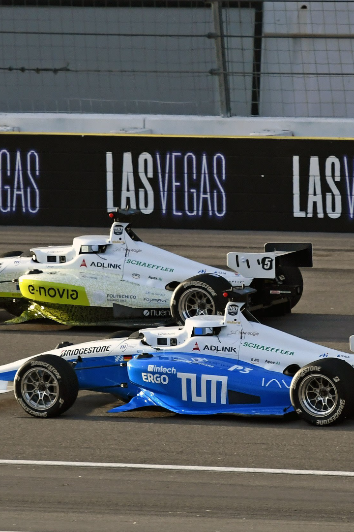
Cone Classification for Dynamic Racing Events
In dynamic racing events, teams compete to have their driverless cars complete a track in the shortest time possible. Autonomous cars are guided by recognizing four types of cones: Big Orange Cones, Blue Cones, Little Orange Cones, and Yellow Cones.
Prepared by
Sudip Kishan Sarker (P44000039)
Niloy Saha (P44000040)
Md Enamul Hasan Sobuj (P44000060)

Slide 2
Contest Rules
1
Objective:
Predict the type of cone using data analysis and Machine Learning techniques.
2
Performance Metric:
Accuracy is the measure to maximize.
3
Tools:
Participants can use external tools like Weka, Knime, and MatLab. We used Jupyter notebook(Anaconda).

Slide 3
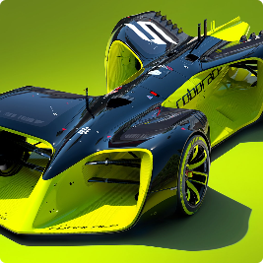
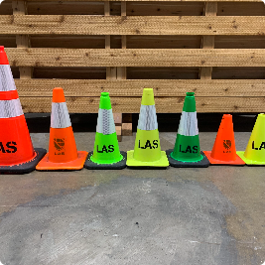
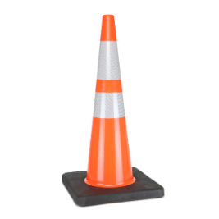
Dataset Description
1
Dataset:
2
Composition:
3
Classes:
The dataset provided by UniNa Corse Driverless Team was obtained from videos of FormulaSAE tracks.
The original dataset contains images labeled with bounding boxes surrounding each cone. The new dataset was obtained by extracting cones from the original images as separate images using the bounding boxes and assigning the respective class ID to each cone image.
The classes are Big Orange Cones, Blue Cones, Little Orange Cones, and Yellow Cones.
Videos of FormulaSAE tracks
New dataset
Types of cones
Dataset obtained from several videos of
FormulaSAE tracks.
New dataset obtained from the original
dataset with cones labeled with their
respective class ID.
The competition aims to classify these cones
using Machine Learning.

Slide 4
Project Overview
Dimensionality Reduction
Downsampling
Performed PCA for dimensionality reduction and used latent components as features in the SVM model
Performed downsampling to address class imbalance
1
2
3
4
Data Processing
Model Building
Pre-processed the data and combined the train dataset
Built SVM and Random Forest models for both ResNet34 and EfficientNet datasets

Slide 5
Data Pre-processing
Imported necessary libraries: numpy and pandas. These libraries are commonly used in data analysis and manipulation tasks in Python.
Combined the train dataset into one single dataset using concatenation. Concatenation is the process of combining two or more datasets together along a particular axis. This step is necessary to prepare the data for machine learning tasks.
Dropped unwanted columns, including Unnamed: 0, images, and cone_name. These columns are not important for the analysis and dropping them can reduce the amount of memory needed to store the dataset.
Checked for the presence of duplicate values and found none. Duplicate values can skew the analysis results and should be removed if present.
Checked for the presence of missing values and found none. Missing values can cause errors in the analysis and need to be handled carefully. Visualizing the absence of missing values can provide reassurance that the data is complete.

Slide 6
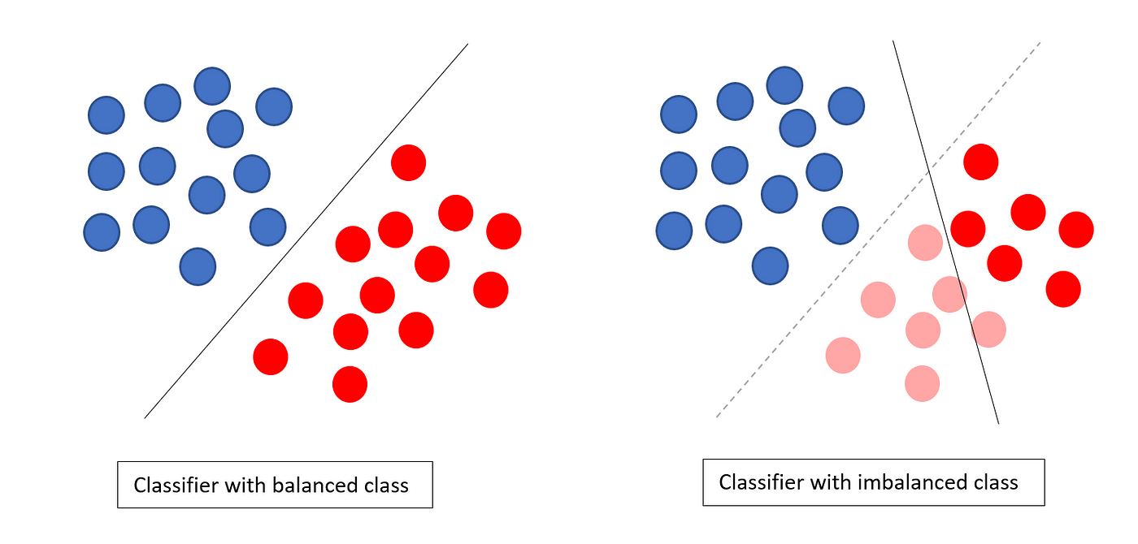
Class Imbalance
Our dataset consists of samples from four different cone classes: Big Orange Cones, Blue Cones, Little Orange Cones, and Yellow Cones. However, the class distribution is highly imbalanced, with a majority of samples belonging to the Blue Cones class.
Addressing class imbalance is important for machine learning models to accurately predict the minority classes. To achieve this, we applied a downsampling technique to balance the class distribution. This technique involved randomly removing samples from the Blue Cones class until the number of samples in each class was equal to the number of samples in the class with the minimum entries.
The downsampling technique resulted in a new dataset with an equal number of samples for each class, resulting in a better representation of the entire dataset.

Slide 7
EfficientNet Dataset
Data Processing
Downsampling
Checked the presence of duplicate and missing values. Checked the distribution of different classes and performed downsampling.
Imported necessary libraries like numpy, pandas, and performed multi-class categorical classification.
Model Building
Dimensionality Reduction
Built Random Forest and Support Vector Machine (SVM) models and checked their performance on the test dataset.
Performed PCA for dimensionality
reduction and used the latent
component as a feature in the
SVM model.

Slide 8
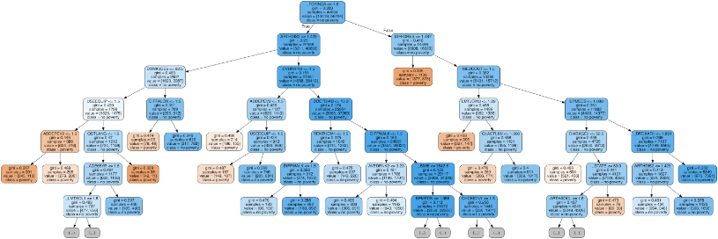
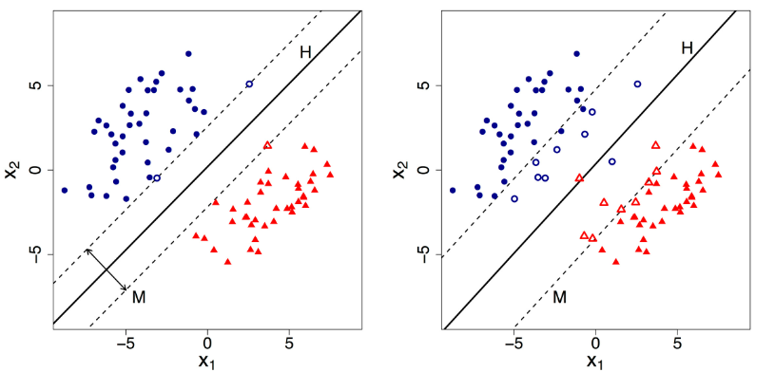
Models Used
Random Forest
The Random Forest model is an ensemble learning technique
that combines multiple decision trees to make predictions.
It is known for its robustness, versatility, and ability to handle
large datasets with high dimensionality. By aggregating the
predictions of individual trees, it produces more accurate and
stable results while also providing insights into feature
importance.
Support Vector Machine
Support Vector Machine (SVM) is a powerful supervised learning algorithm used for classification and regression tasks. It finds an optimal hyperplane that separates different classes in the data by maximizing the margin between them. SVM can handle high-dimensional data, works well with both linear and nonlinear relationships, and is effective in handling outliers.

Slide 9

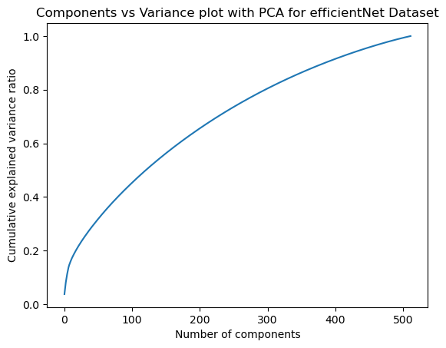
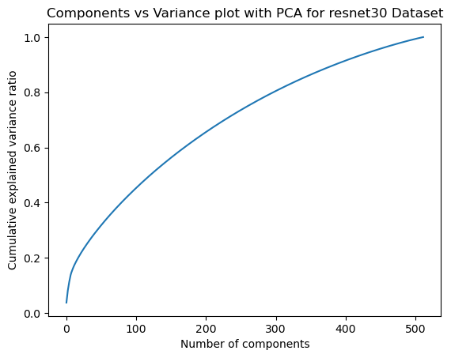
Dimensionality Reduction - PCA
PCA is a technique used to reduce the number of dimensions in a dataset while retaining most of the data's variation. In our case, we applied PCA to our high-dimensional dataset to visualize the data in a lower-dimensional space.
We then used the latent components obtained from PCA as features in our SVM model. This allowed us to build a more efficient and accurate model, as compared to the one built using the original high-dimensional dataset.
After applying PCA, we achieved an accuracy of 95% and a precision of 96%. These metrics indicate that our model is performing well and can be used for the classification task at hand.

Slide 10
ResNet34 Dataset
1
Data Processing
2
Model Building
3
Dimensionality Reduction
Followed similar steps to the EfficientNet dataset.
Built Random Forest and SVM models and checked their performance on the test dataset.
Performed PCA for dimensionality reduction.
4
Model Performance
ResNet34 models performed better than EfficientNet models.

Slide 11
Model Performance Comparison:
Dataset
Random Forest
SVM
SVM with PCA
efficientNet
73%
84%
85%
resnet34
92%
94%
96%

Slide 12

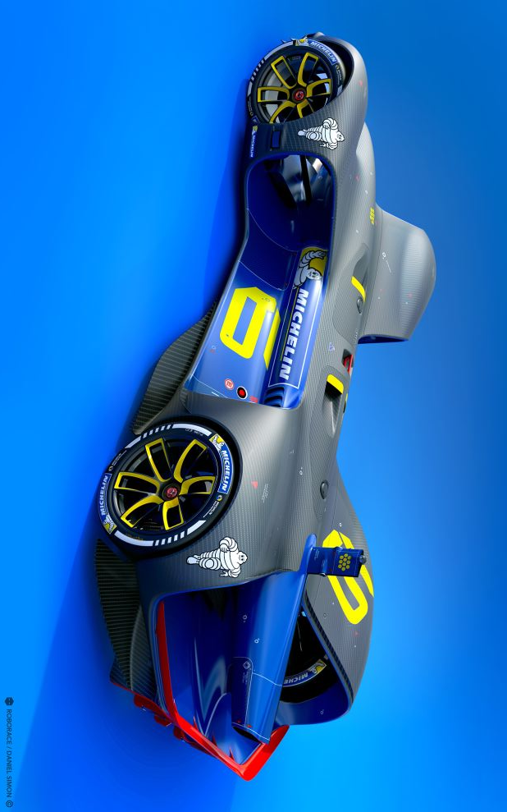
Conclusion and Future Work
1
Objective Achieved:
2
Future Work:
Successfully classified cones using machine learning techniques and achieved high accuracy.
Exploring other pre-trained neural networks and improving the downsampling technique to address class imbalance.

Slide 13
